Slide 1


Storage resources at UiT
Tromsø, 6. December 2021
Erik Axel Vollan, IT department
Research data @ UiT
CC BY 4.0

Slide 2
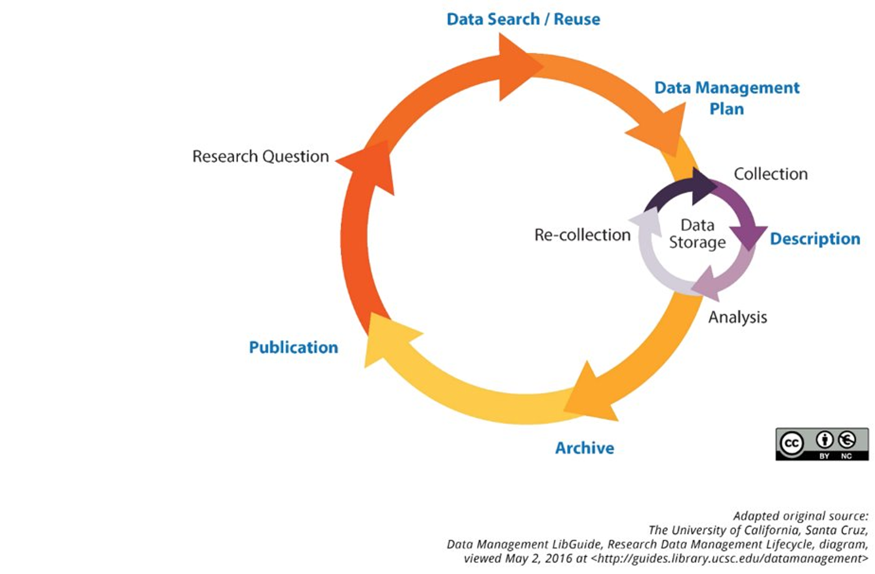
Storing vs Archiving
Storing
Collecting
Raw data
Active data
Analyse og bearbeiding
Safekeeping
Archiving
Deposit in archives
Publishing
Data made findable and reusable

Slide 3
3 main points of information security
Confidentiality
Information is accessible only for users authorized for it
Integrity
Information is protected from unauthorized deletion and manipulation
Accessibility
Information is accessible to users when they need it

Slide 4
In practical terms
Data
Classified according to confidentiality
Stored in a system that protects against unauthorized change and deletion
Stored on a backed-up system to prevent data loss

Slide 5
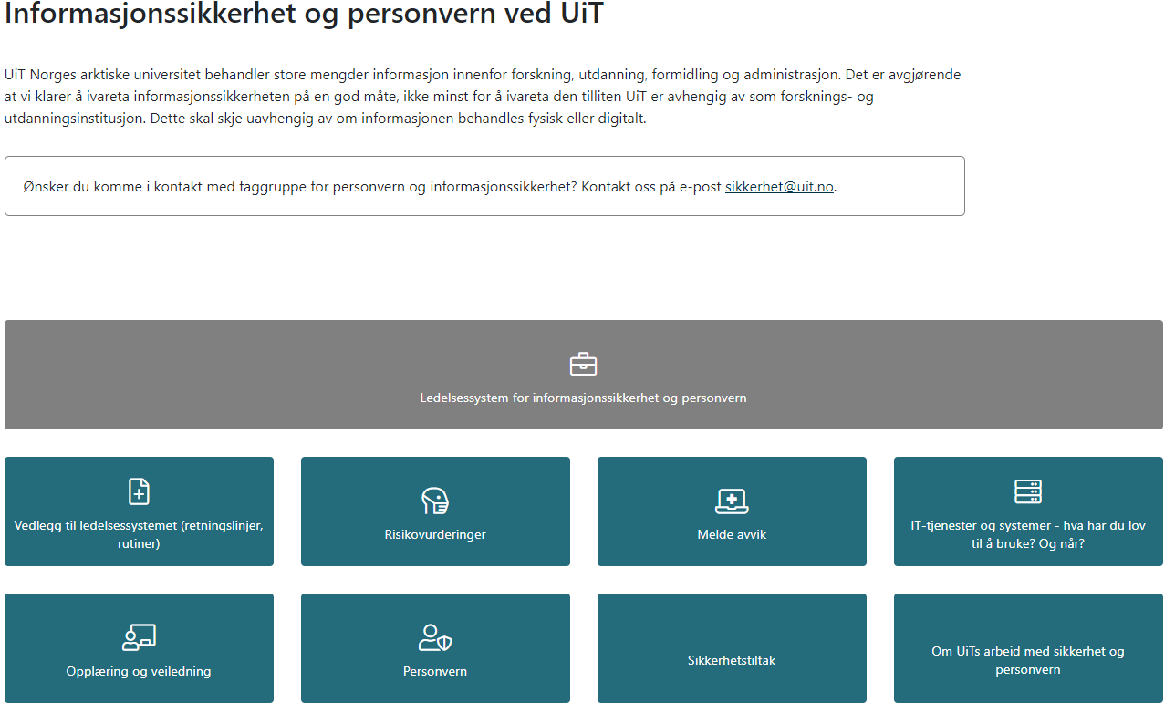
Classification
https://uit.no/sikkerhet

Slide 6
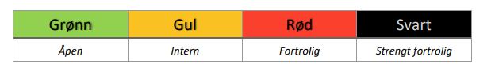
Information must be classified. UiT Information Security Governance System Chapter 3
Guidelines in Chapter 3 (In norwegian).
4 classes:
The information owner is responsible for classifying

Slide 7
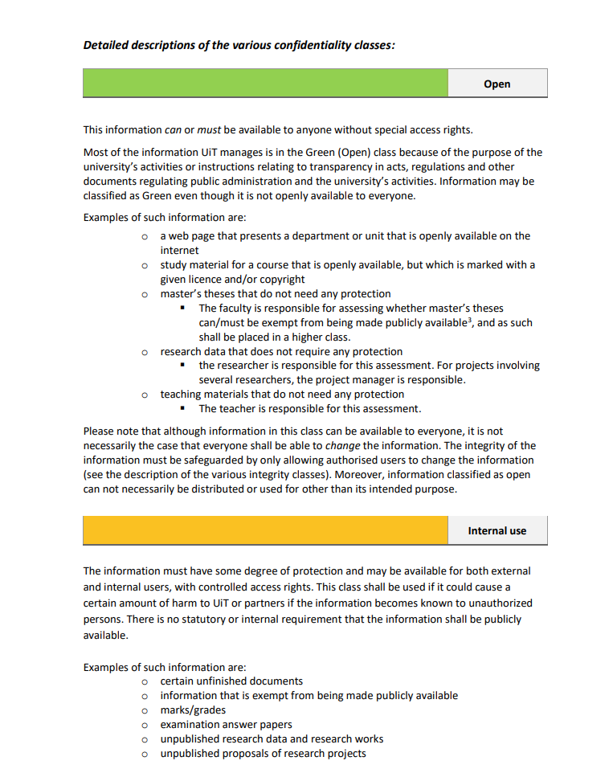
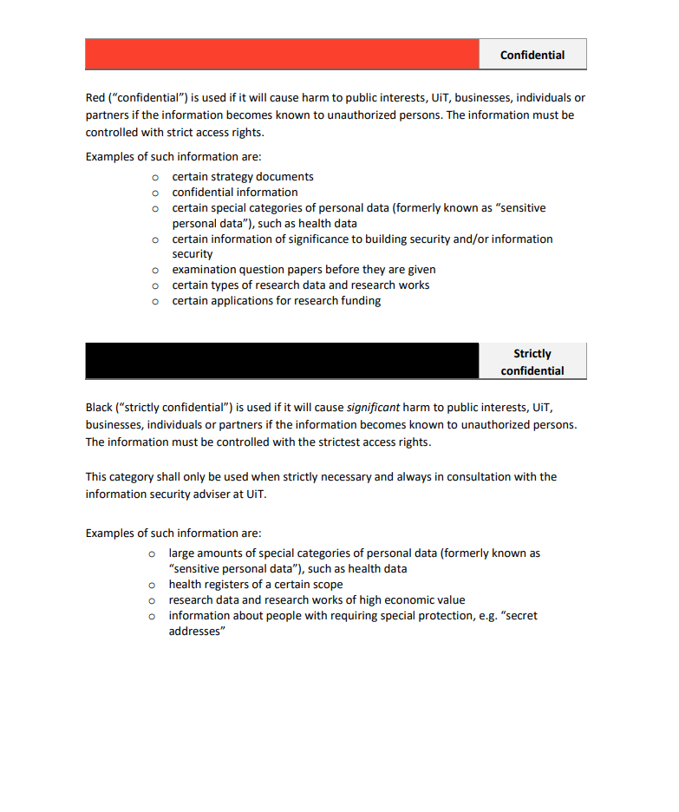
Criteria for classification classes

Slide 8
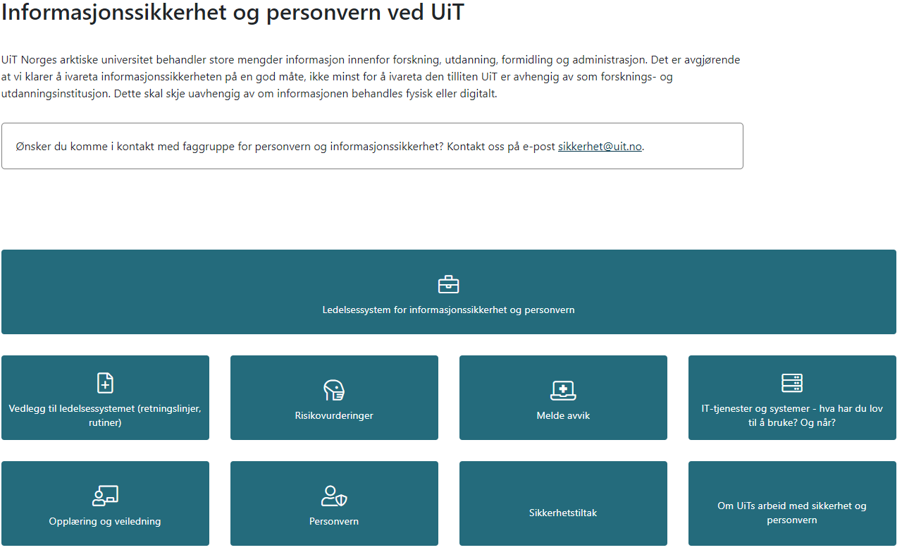
Services allowed
https://uit.no/sikkerhet

Slide 9
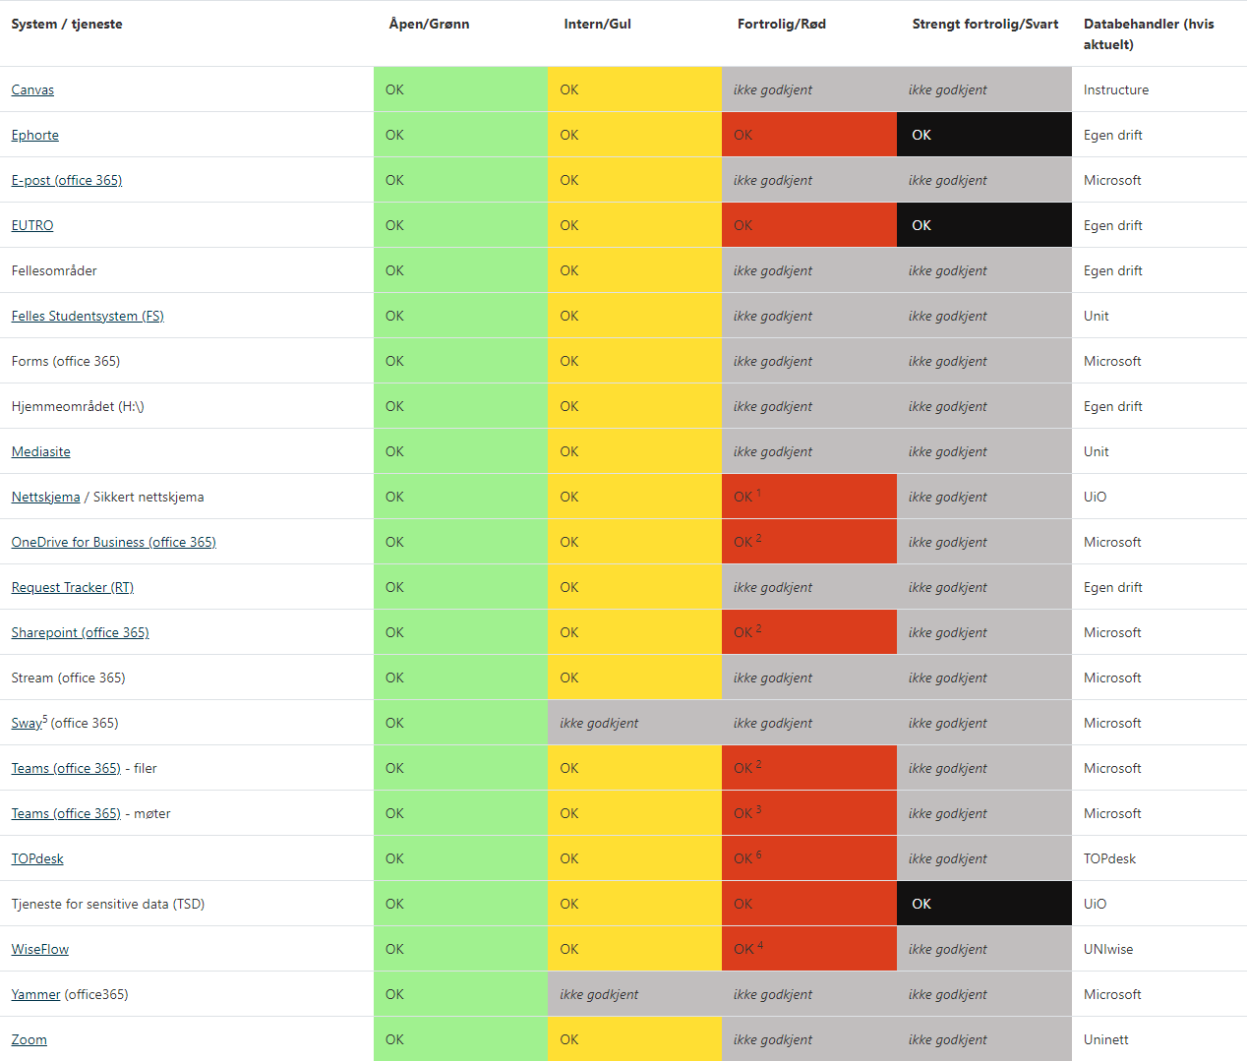
Services allowed
Notes:
March-21: Do all know what "H disc" means? Focus less on services not related to research. Use animations to help people see what you talk about.

Slide 10
Store data on a secure backed-up system
Integrity Availability

Slide 11
Office 365
Office 365 is UiT’s primary collaboration and storage tool Departmental shared disks will be moved to Teams/Sharepoint in 2021 The home folders will be moved to OneDrive
Notes:
AIP = Azure Information Protection

Slide 12
Office 365 for research data
Teams/SharePoint – groups and projects
OneDrive – personal storage. NB!! Is deleted when users leaves UiT!
Notes:
AIP = Azure Information Protection

Slide 13

Office 365 lets you share data
Users you are sharing with must have an Office 365 account and can be invited as guests
You administer sharing yourself
ITA can help you
To send (large) files: Uninett Filesender
https://filesender.uninett.no
Notes:
Problem.
Autentisering utenfor vårt AD
Ikke bare vi som sliter.

Slide 14
Local storage resources
Research data service
Not directly mountable on client computers
Up/Download via terminal server client
Contact the helpdesk for space
Notes:
Kryptovirus
Frikoble bruk fra klientmaskiner.
Masterkopi
Arbeidskopi

Slide 15
Governance
Base quota of 5 TB free storage per user.
Pricing model for large projects (0.5 – 1 NOK/GB/Year)
Notes:
Each user can have 5 TB
10% of users use 90% of resources
Big projects sent to national services
NIRD
Sigma2 HPC
Arven etter Nansen

Slide 16
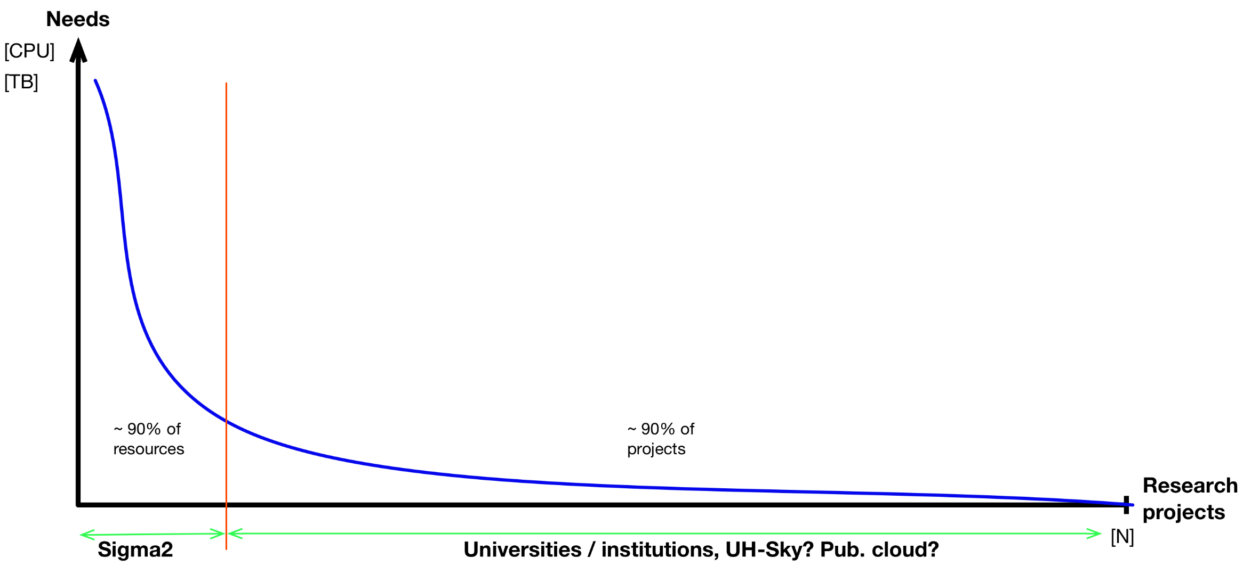
Projects with LARGE storage needs
Credit: H. Eide, UNINETT Sigma2:

Slide 17

National e-infrastructure for high-performance computing and storage
Supercomputers in Tromsø og Trondheim
Storage through NIRD - National e-Infrastructure for Research Data
For storage needs from 10TB and above
Has its own resource allocation procedures
More info: https://www.sigma2.no/

Slide 18
Storing sensitive data
Red data can be stored in Office 365 on 2 conditions
Your account must be set up with 2-factor authentication – all employees are
Data must be protected with Azure Information Protection (AIP)
Built in tool in Office programs (Word, Excel)
Can protect other file formats through a manual procedure
Requires decrypting before you can work on file

Slide 19
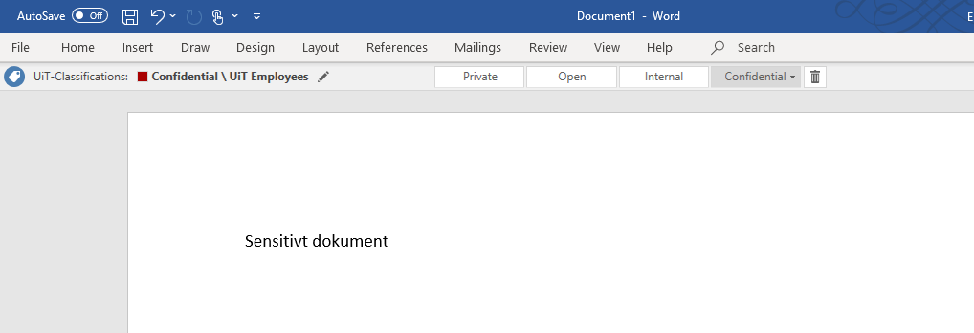
Azure Information Protection
Built in tool in Office programs like Word, Excel
Encrypts data according to classification

Slide 20

Services for Sensitive Data
UiT buys this service from UiO
Closed environment for storage and analysis
Statistics
NVIVO
Very high level of security
Strict controls of data import and export
All projects totally isolated from other projects
Nettskjema can send encrypted forms directly to TSD
Smartphone Dictaphone app can send directly to TSD
For more info : TSD web pages
Cost for projects: NOK 15000 / year
UiT ITA can give limited local support.

Slide 21
ITA work in progress
Cloud-based services – the future of ITA at UiT
Applications and storage – increased flexibility and dynamics
Cloud-based student labs Departmental shared drives moving to SharePoint Home folders moving to OneDrive
Better tools for red data
HUNT Cloud will be available for UiT users
Remote Desktop-tjeneste for red data – «TSD Light»
Notes:
Vi VET at dette mangler.
Prøver å finne ressurser.
JUS kommer inn for sky.

Slide 22
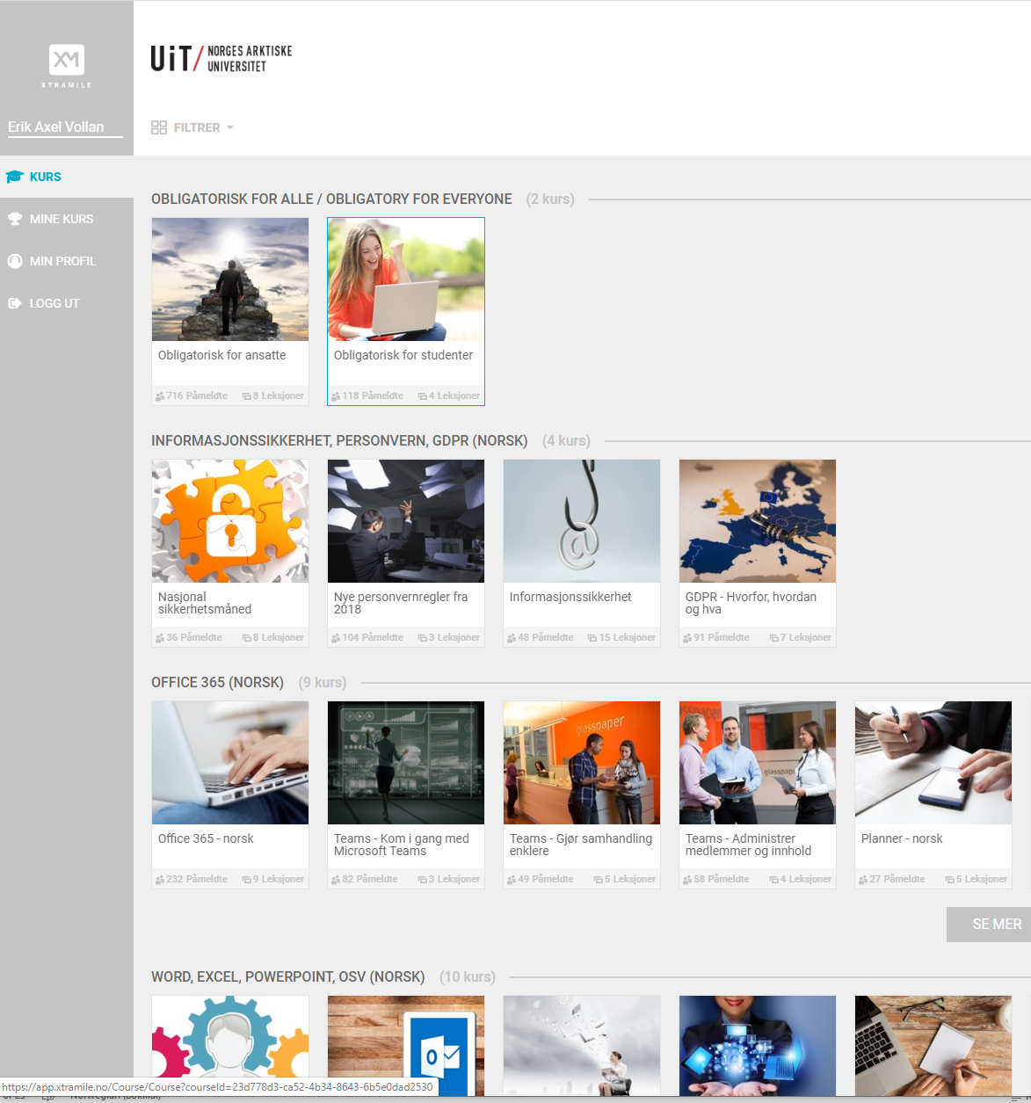
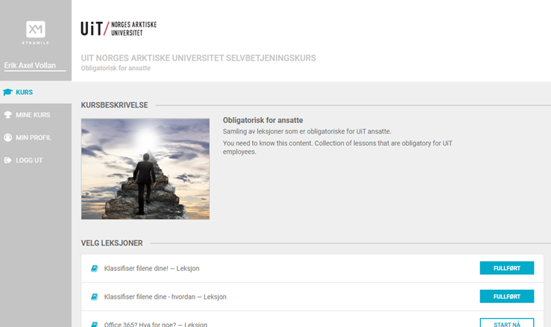
E-learning on Office 365 https://app.xtramile.no/courses/uitnorgesarktiskeuniversitet

